Slide 1

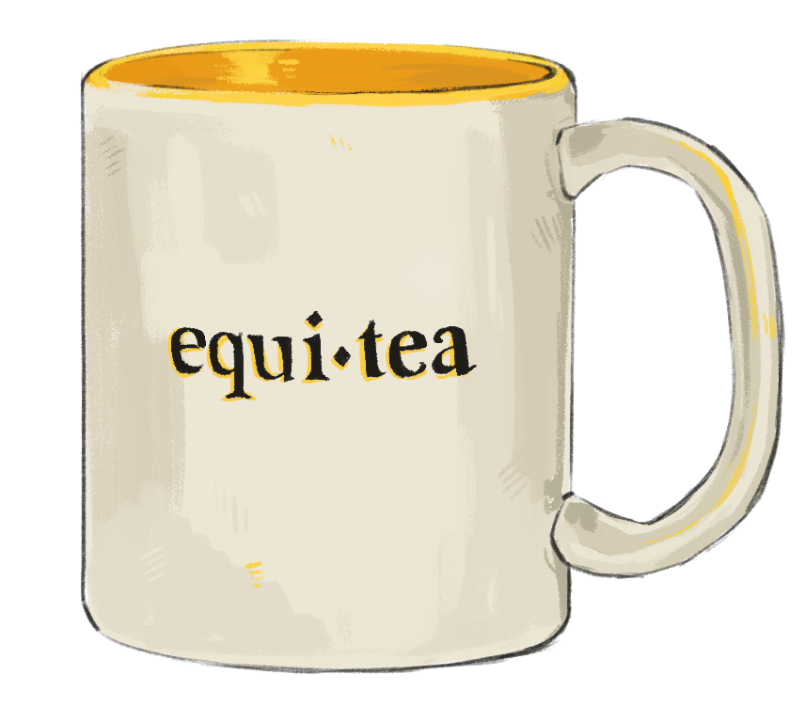
Equitea ED&I Initiative
Proposed by Jenni French & Alicia Kendall
Backed by Hannah Lerman & Simon Vaughan
Slides adapted from Ares Osborn (Warwick) and Sean O’Brien (Belfast)

Slide 2
1.
What is Equitea?
What can Equitea do for you?
2.
3.
When is Equitea meeting?

Slide 3
WHAT IS AN EQUITEA?
“
A monthly forum to discuss equity, diversity and inclusion (ED&I) in relation to Astronomy, Physics, and/or STEM as a whole.
- Astronomy and Astrophysics Group, University of Warwick
”

Slide 4

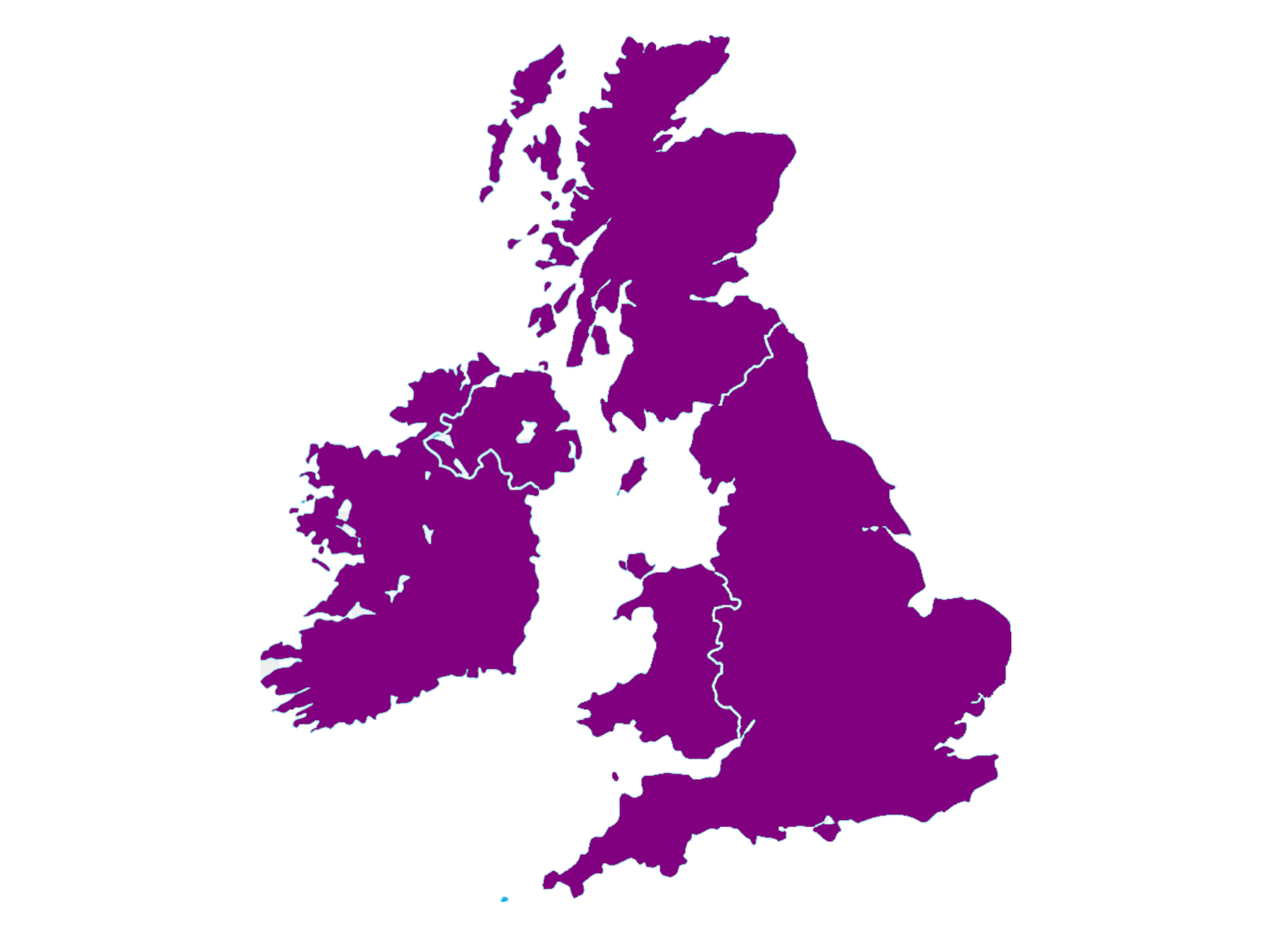
Michigan •
https://sites.google.com/umich.edu/astro-dei/initiatives/equi-tea
Notes:
We can’t take credit for this idea, it’s come along an ‘EDI chain’ to us. Since 2017, the Astronomy department at University of Michigan has been running an Equitea.

Slide 5
QUB •
• Leicester
Warwick •
https://warwick.ac.uk/fac/sci/physics/research/astro/seminars/equitea/
Notes:
This idea made it across the ocean to us through Ares Osborn at University of Warwick. They led the set up for an Equitea at Warwick around January this year and ran a really good EDI session at UKEXOM over summer 2023.

Slide 6
QUB •
• Leicester
Warwick •
Equitea being established!
Notes:
In that same session, Sean O’Brien of Queen’s University Belfast gave a presentation on how to set up an Equitea after working with Ares during his time at Warwick.

Slide 7
QUB •
• Leicester
Warwick •
Notes:
This has inspired us to set up our own!

Slide 8
HOW WILL IT WORK?
Hour session: 20-25 mins seminar followed by discussion
External Speakers: invited to bring perspectives we may not have experienced
Informal friendly atmosphere: Cake & coffee provided!
Every second Tuesday of the month → 1st Meeting: 2pm 10th October in F10/F11

Slide 9
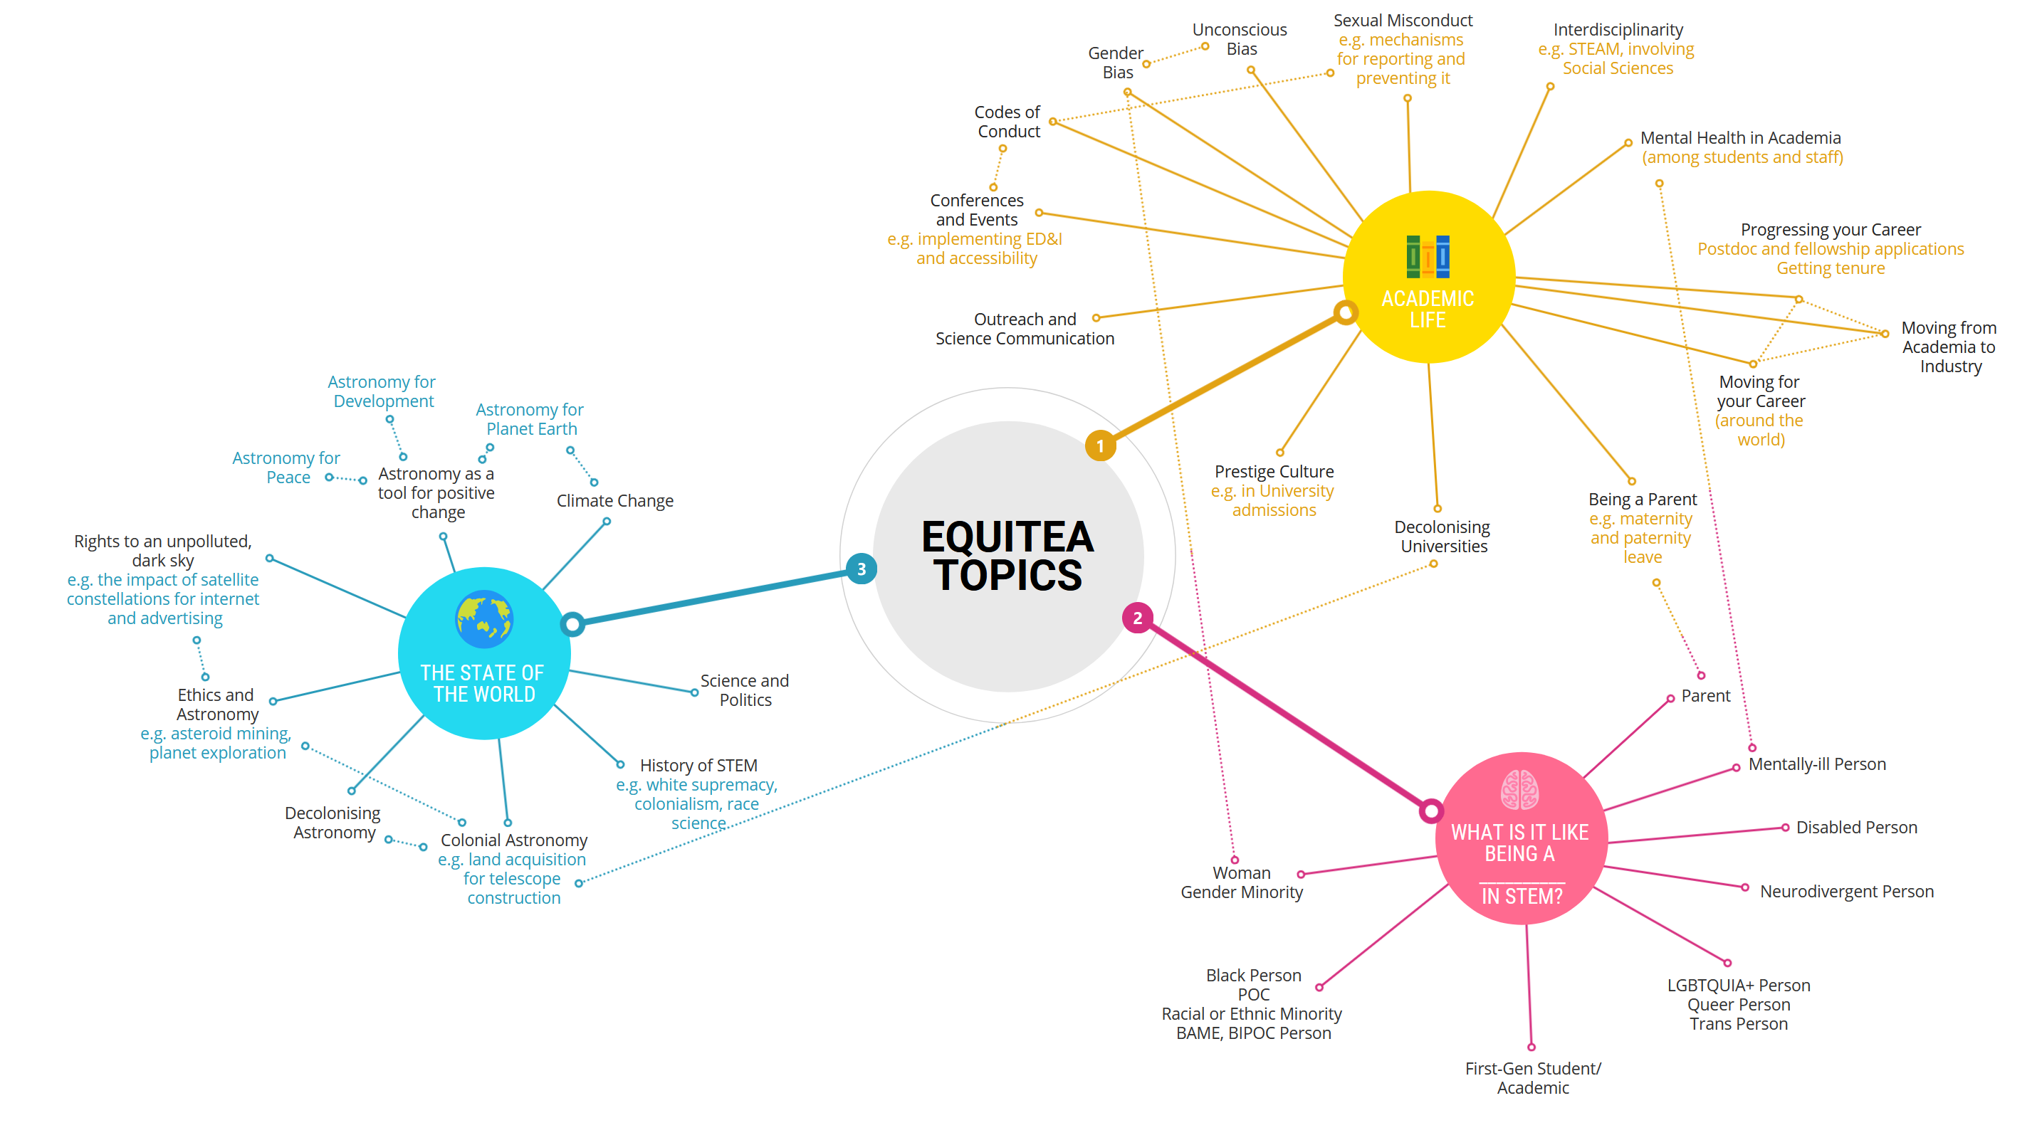
POTENTIAL TOPICS OF DISCUSSION AT EQUITEA
NOT an exhaustive mind map!
Notes:
So what sort of topics are up for discussion at an Equitea session? Whilst this is not an exhaustive mind map and a large majority are all interconnected, let’s take a look at a few.

Slide 10
POTENTIAL TOPICS OF DISCUSSION AT EQUITEA
NOT an exhaustive mind map!
Notes:
Plenty of topics can affect our affecting academic lives and career journeys such as gender bias, decolonizing universities and mental health in academia.

Slide 11
POTENTIAL TOPICS OF DISCUSSION AT EQUITEA
NOT an exhaustive mind map!
Notes:
Similar to the previous category, we also need to think about obstacles to science for certain groups of people. In this, we all have room to learn. Whilst I like to think I try hard to consider others, Sean asked the room a question at UKEXOM that really made me realise how necessary ideas like an Equitea are. He asked us to think about the last time we networked with a black female physicist at a conference, and at that moment I became aware how predominantly white the conference was. Here at Leicester, we have Dr Maggie Aderin-Pocock as our Chancellor, which is wonderful and all, but I wonder how many other black female physicists you can name or know.

Slide 12
POTENTIAL TOPICS OF DISCUSSION AT EQUITEA
NOT an exhaustive mind map!
Notes:
Personally as a ground based observer, a lot of this section is relevant to me. For instance, a sky filled with satellites would be no good for my work. Or in the context of building new ground based telescopes, it’s important to think about colonialism in astronomy, which also came up at the UKEXOM EDI session, since certain sites for building telescopes are important to local populations, both culturally and environmentally.

Slide 13
WHAT CAN EQUITEA DO FOR YOU?
1.
EDI affects us all
Everyone in this room will have experienced an EDI issue (or solution) either directly or indirectly
The onus should not be solely on those affected to make change
Notes:
To finish, I’d like to point out why coming to Equitea can benefit yourself, even if you don’t consider yourself a minority or part of a marginalized community. Firstly, EDI can affect us all, either directly or indirectly. Any one of us could easily find our situation changing, such as developing a chronic illness or disability, or becoming a parent in the future, and I’m sure you would like it to be easier to continue in the Astrophysics community if that happened. And even if an issue doesn’t affect you directly, the onus to create change should not be solely on the group affected.

Slide 14
WHAT CAN EQUITEA DO FOR YOU?
2.
Help your students, help yourself!
Happy, supported students perform better
Making your content more accessible helps everybody – and saves you time in the long run
Notes:
Secondly, this one is mainly aimed at staff, but also at those of us postgrads who teach as well. Working to foster an inclusive culture within the department will help students feel supported and comfortable, making it easier for them to do well. One of the early sessions we plan to do is on lecture and powerpoint slide accessibility, which should make it easier your students to learn within your lectures and save you time going back over topics because it wasn’t suited to them later.

Slide 15
WHAT CAN EQUITEA DO FOR YOU?
3.
Citizenship Hours
As staff members, attending and contributing to Equitea can count towards your citizenship hours!
Notes:
For academic staff, as part of the workload model, attending and contributing to Equitea and the EDI committee counts as part of your citizenship hours. A nice coffee, cake and wholesome chat seems a great way to meet this requirement.

Slide 16
WHAT CAN EQUITEA DO FOR YOU?
4.
Flexible Sessions
You don’t have to come to all the sessions!
Please don’t feel you have to come to sessions that might be difficult for you
If you’ve got a clash, let us know! We can look into shifting the session :)
Notes:
We would love people to attend as many Equiteas as they can, but if you can’t make it that’s okay! Some sessions may be a little more challenging, and if that might be too much for you for personal reasons, we fully understand if you can’t attend. We’re also open to moving the timeslot where possible in order to accommodate as many people as possible, so if you have a clash preventing you from coming, please do let us know and we can look into it!

Slide 17
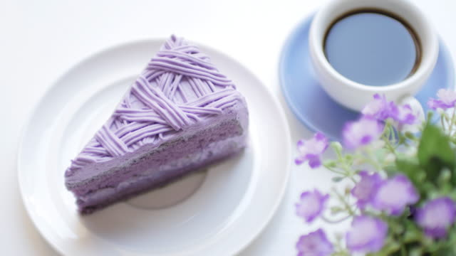
WHAT CAN EQUITEA DO FOR YOU?
5.
Cake & Coffee!
Notes:
Finally, we have been given a budget for cake and hot drinks, which should be enough to persuade the PhD cohort at the very least, but we’re hoping to see as many as possible there.

Slide 18
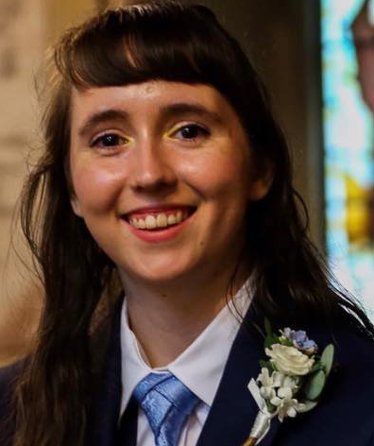
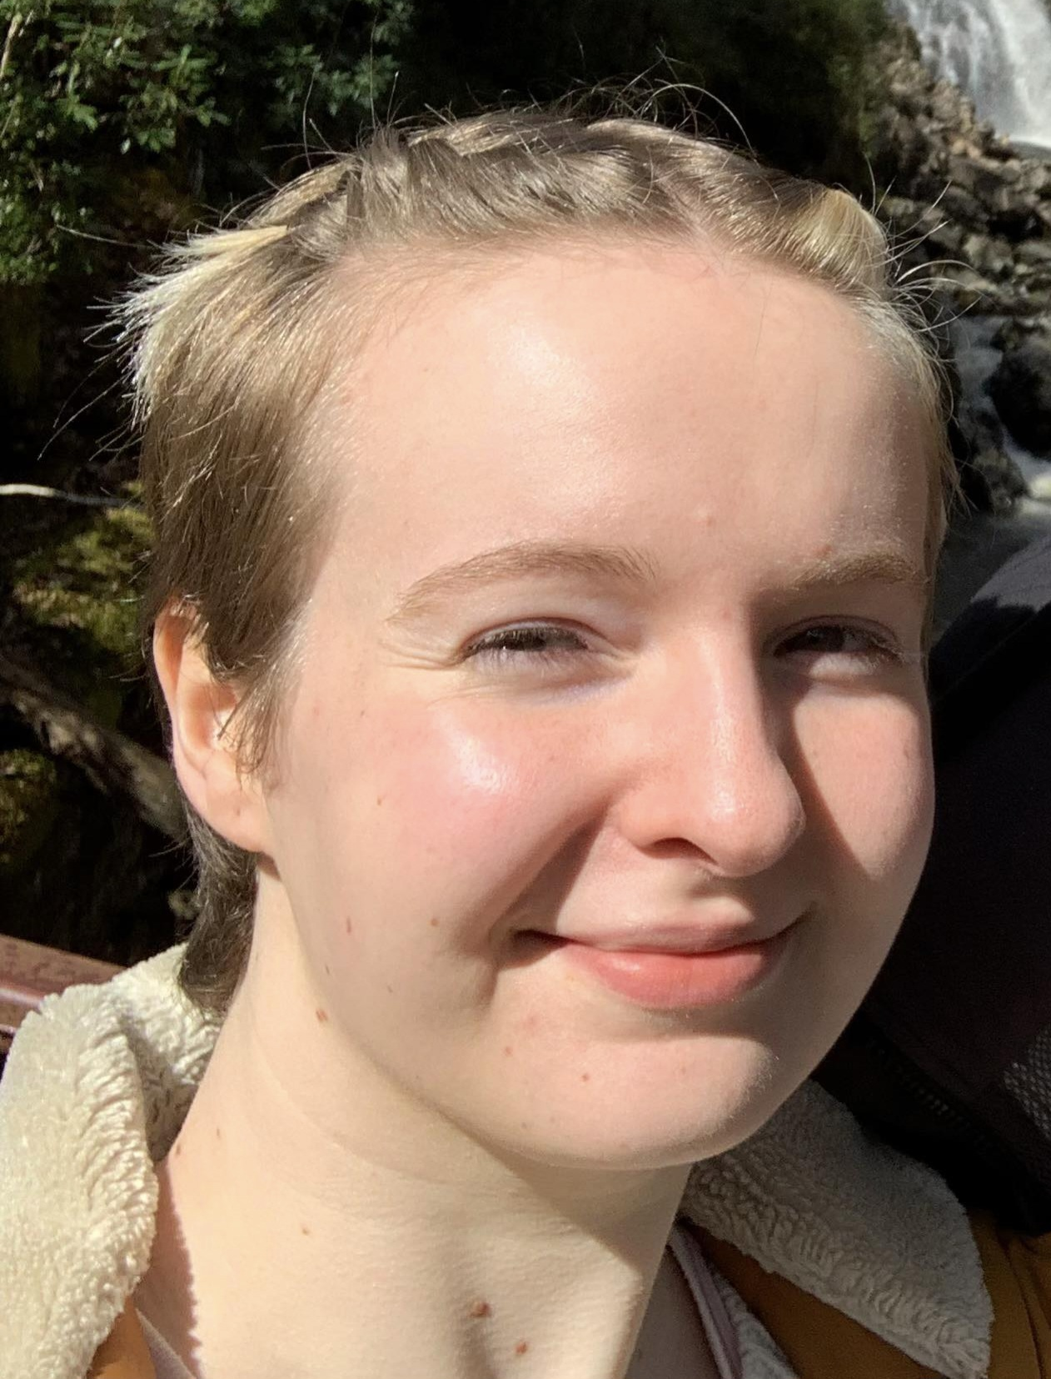
QUESTIONS? CONTACT US!
Jenni French (she/her) jf328@le.ac.uk |  |  | Hannah Lerman (she/her) hnl4@le.ac.uk
Alicia Kendall (she/her) ak842@le.ac.uk |  | EDI Physics equalities-physics@leicester.ac.uk
Notes:
If you’d like to get involved in the organizing of Equitea or you have any questions, please come and talk to us! Please direct any comments/questions to Jenni primarily, but feel free to contact Alicia & Hannah / EDI Physics as well :)

Slide 19
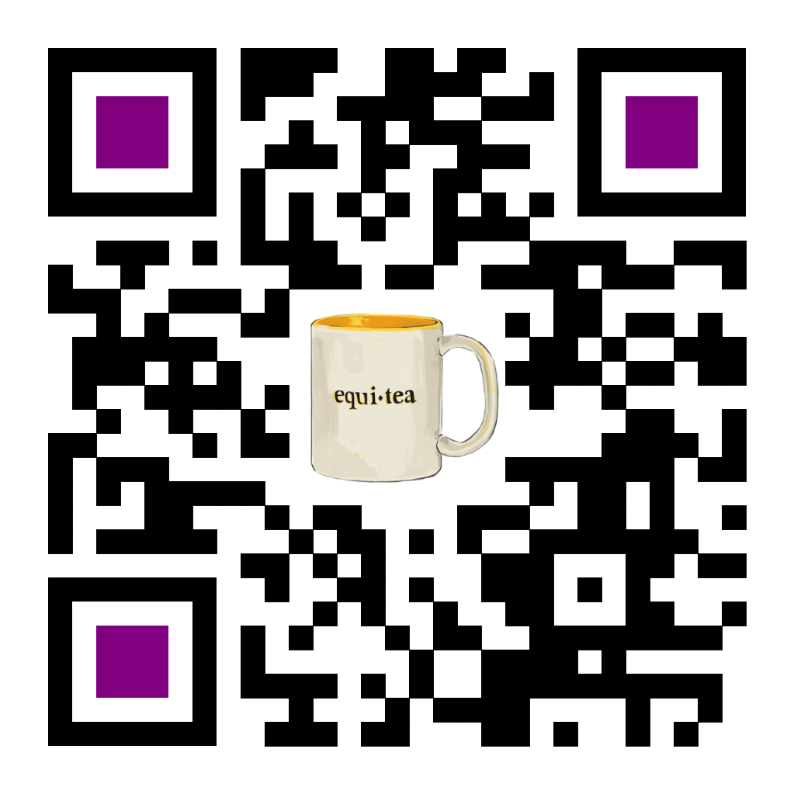
Come join us for an introductory meeting! Tuesday 10th October 2pm F10/F11
Got a suggestion for a discussion topic for a session? Submit it here!
Notes:
So please do come join us for our first meeting where we’ll talk about the format and topics for future sessions. You can find us in F10/F11 at 2pm on Tuesday the 10th October.

